Slide 1

Regional Trainings-GMS and Prevention Data Portal
Michelle Nienhius, MPH
Manager, Division of Prevention and Intervention Services
Notes:
Custom DAODAS color codes is : Red-0
Green-131
Blue-139

Slide 2
Grants Management System
What is it?
DAODAS Grants Management System (GMS) is a web-based, software-as-a-service solution that supports the entire grant lifecycle workflow from pre-qualification, solicitation, proposals, award, contract, invoice, reporting, monitoring and closure.
Why?
The system is an essential technology component of embedding digital capabilities within DAODAS, as part of the state agency’s continuing digital transformation.
What is the impact on County Authorities?
The GMS is a project management tool. The County Authorities will be able to see DAODAS funding/program announcements; communicate needs assessment; submit applications; receive award offers; document and store contracts; set and manage goals, objectives, track activities, performance; update performance metrics; allocate and track budget and accounting; request disbursement, drawdown, reimbursement; submit cost/expense documents; request carryovers, extensions/renewals; view/print reports and manage closeouts.

Slide 3
Grants Management System
Three Components of new DAODAS Grant Management System
Pre-Award (DAODAS Grant Application Portal): Training has been provided
  Applications will be posted and completed for review. Each agency that completed the MAT application should have an agency login for completing future applications.
  DAODAS will gradually be utilizing the pre-award site for new funding opportunities such as the new SOR that we anticipate receiving in October.
  If funded, application components move over to post-award to include goals, objectives, performance measures and budgets. This is what DAODAS is currently populating for each county from the County Plan.
Post-Award (GrantVantage): Training has been provided
  Grant reporting on accomplishments, reimbursement requests and responding to deliverables outlined in the contact will be monitored in the GrantVantage platform.
  Licenses are required, therefore each agency will receive 4/5 logins that will be assigned to key staff. (Dynamics Users)
Data Collection (DAODAS Portal): This is what we will cover today
  Prevention Service data will be entered into the portal
  Portal will connect to Performance measures, objectives and goals in GrantVantage
  Reports are in development and will be completed this fall

Slide 4
Pre-Award
Brief Overview

Slide 5
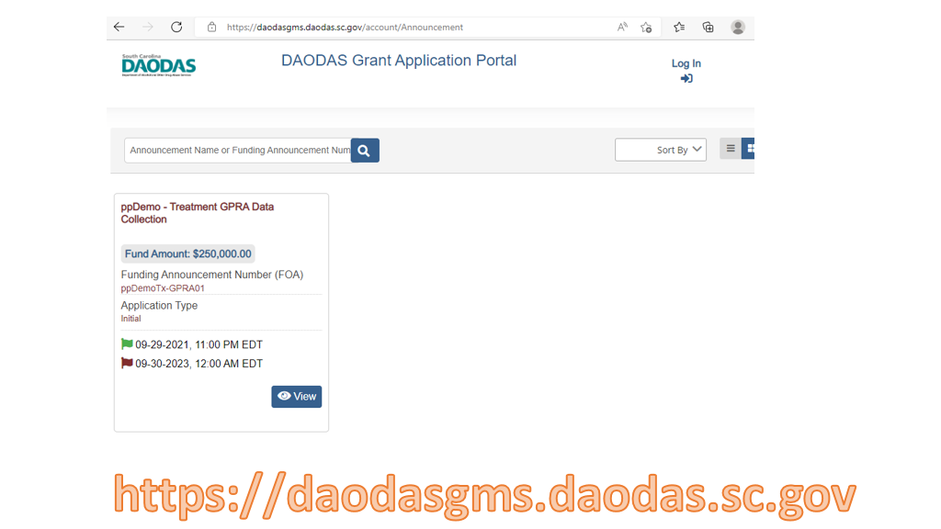
Grants Management System

Slide 6
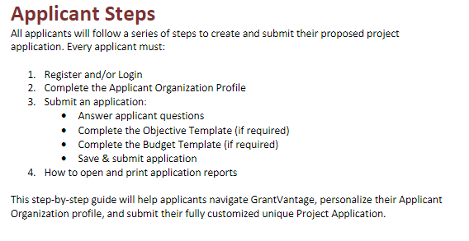

Slide 7
Post-Award
Brief Overview

Slide 8
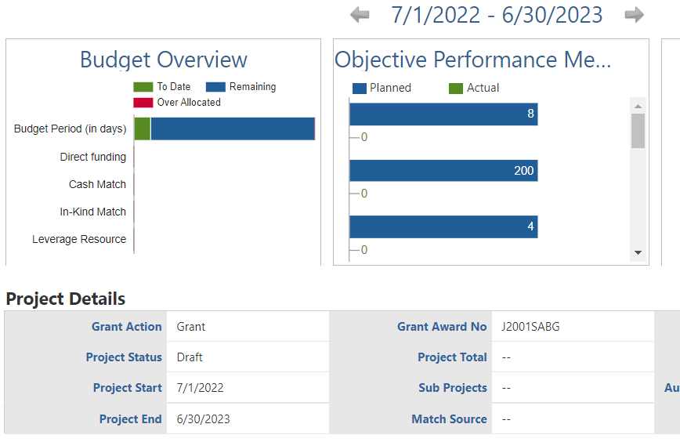

Slide 9
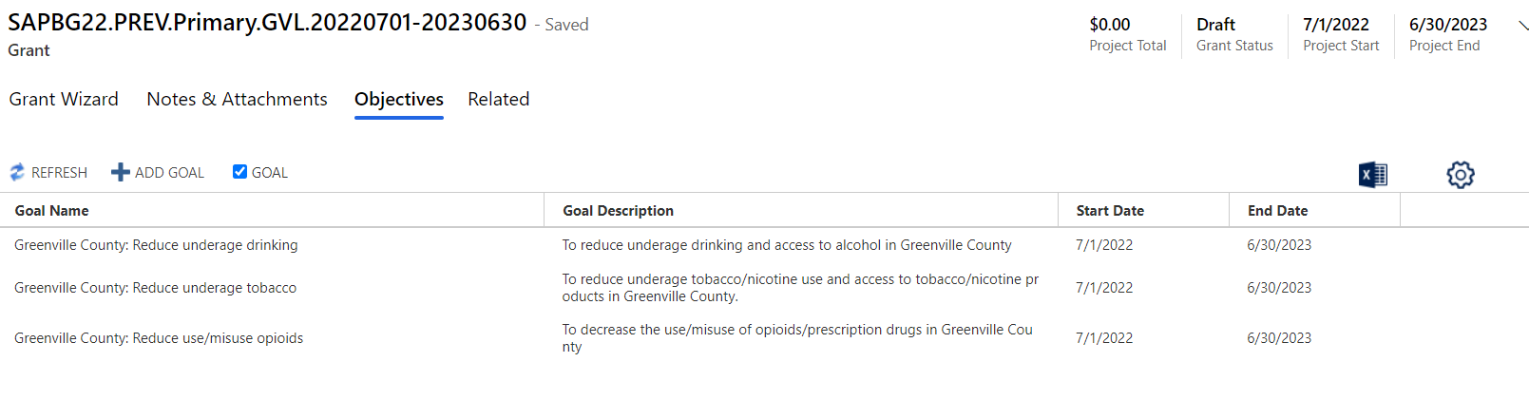

Slide 10
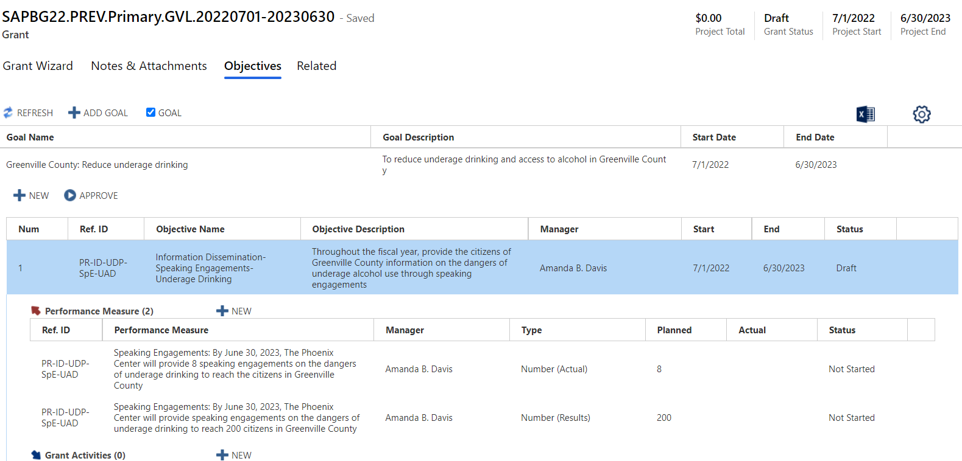

Slide 11
Sample Reports: The DAODAS Portal solution is accessible from the DAODAS Portal change area of the GrantVantage
application. This area contains entities, forms, and views that are designed to support Portal Submissions.

Slide 12
The Portal Solution is comprised of the following entities:
Portal Submissions
Participants
Demographics
Counties
Portal Submission Records:
The Portal Submissions entity contains records of online forms submitted by authorized users who are facilitating events and activities as required by grants awarded to the portal user’s organization.
Submissions capture details related to the event or activity including but not limited to date and time, location, organization, and demographics of the participants in attendance.
Each time a form is submitted, a record of the form is created in the Portal Submissions entity.
Dynamics users (GrantVantage) are able view the data by clicking on the Submission ID (primary attribute of each record), which opens the form.

Slide 13
The Portal Solution is comprised of the following entities:
Portal Submissions
Participants
Demographics
Counties
Participants
The Participants entity tracks records of Staff Member and Volunteer participation for all Portal Submissions, including time spent planning and facilitating the event or activity. When a form is submitted via the portal, a record is created in the Participants entity. The record is also appended to the Portal Submission record in a sub-grid for quick access.

Slide 14
The Portal Solution is comprised of the following entities:
Portal Submissions
Participants
Demographics
Counties
Demographics
The Demographics entity is used to capture the Age, Race, Gender, and Ethnicity of citizens who attend the Educational events or activities facilitated by the portal user. Since an Educational event or activity can be comprised of multiple sessions, this entity supports the portal user entering the demographics for each session.

Slide 15
The Portal Solution is comprised of the following entities:
Portal Submissions
Participants
Demographics
Counties
Counties
The Counties entity contains a list of all 46 counties in South Carolina along with each county’s jurisdiction and the designated AET Coordinator. This list is used to assign counties to portal users indicate the county in which the event or activity occurred.

Slide 16
GrantVantage Integration
When a form is submitted via the portal, a workflow on the backend is triggered to validate the
Metric Increment set on the Performance Measure selected for the submission. The workflow
increments the Actual based on the rule. Below are samples of the Metric Increment Rule:
• Increment By Handout – Adds the number of Handouts indicated on the submitted form to the
Actual amount.
• Increment by Views– Adds the Count of Views indicated on the submitted form to the Actual
amount.
• Increment by One – Adds the submission as a count of One to the Actual amount.
• Increment By Total Served – Adds the Total Number Served indicated on the submitted form to
the Actual amount.

Slide 17
Using the example in the screenshot, the total number of citizens/participants served as of the
submission of the form is 56 out of a planned 1200.

Slide 19
Data Collection Portal
Portal URL: https://das-prod.powerappsportals.us

Slide 20
Platforms
The most recent version of iOS is recommended to run Power Apps for mobile devices, noting the previous version meets the minimum required.
Browsers
The following browsers are supported for using Microsoft Power Apps portals:
Google Chrome
Microsoft Edge
Mozilla Firefox
Apple Safari
NOTE: Internet Explorer is not supported for Microsoft Power Apps portals.

Slide 21
Operating Systems
The operating systems listed below are supported for running Microsoft Power Apps portals.
Windows 10 or later
macOS 10.13 or later
iOS 13 or later
Android 10 or later
Access
Access to the DAODAS Portal is granted one of two ways:
1. Via Portal Invitation triggered from the Dynamics 365 GrantVantage application
2. Via Self-Registration

Slide 22
Portal Invitation User Experience
The DAODAS Prevention team will trigger the invitation which sends an email to the user. The recipient will click on the URL in the email invitation to navigate to the portal.

Slide 24
Self-Registration User Experience
On the DAODAS Portal Home page, click Sign in.
Click on the Register tab.
Complete the registration information under “Register for a new local account,” and then click the Register button. The Profile screen displays.
Complete the required fields under Register for a new local account, and then click the Register button. The Profile screen displays.
An email is sent to DAODAS Prevention team to set up the user. Upon completion of the set-up, the DAODAS Prevention team will notify the user that the registration process is complete.

Slide 25
Navigation
The DAODAS Portal is comprised of a Home Page, Forms library, and a My Forms view. Users must complete the portal registration process and be signed in to access each page. The sections below offer an overview and/or functionality of each page.
Home Page
The Home Page offers information about the portal, including instructions and important dates
Forms
The Forms library includes forms grouped by strategy. By default, strategies are collapsed. Clicking the drop down next to a strategy displays the related forms.
Clicking on a form launches the form detail. Each form contains a series of fields for reporting on an event or activity. The top section in each form contains fields that display a list of options that are filtered based on the authenticated user’s set-up in Dynamics 365 (D365), which is managed by the DAODAS Prevention team.
The Organization field displays only those organizations to which the authenticated user is assigned in D365.

Slide 27
Clicking on a form launches the form detail. Each form contains a series of fields for reporting on an event or activity. The top section of each form contains fields that display a list of options that are filtered based on the authenticated user’s set-up in Dynamics 365 (D365), which is managed by the DAODAS Prevention team.
The Organization field displays only those organizations to which the authenticated user is assigned in D365.

Slide 28
Information Dissemination
Speaking Engagements** **Ones highlighted in red require demographics
Health Fairs and Other Health Promotion **
Social Media Postings- requires number of views/impressions
Media Campaigns- requires number of views/impressions
Radio and TV Public Service Announcements- requires number of views/impressions
Town Hall Meetings **
AET Casual Contacts **
Brochures, Factsheets, Newsletters, Handouts- requires number
MADD Power of Parents **
MADD Power of Youth **
Clearinghouse/Information Resource Centers **

Slide 29
Community-Based Processes **Ones highlighted in red require demographics
Multi‐Agency Coordination/Collaboration/Coalition Meetings**
Youth Boards/Coalitions Meetings **
Community and Volunteer Training/Technical Assistance **
Systematic Planning- require staff hours
Needs Assessment- require staff hours
Accessing Funding/Grant writing- require staff hours
Recognition Activities **
Education
Educational Services for Youth
Education Services for Adults
Parenting and Family Management

Slide 30
Alternatives (all require demographics)
Alcohol and Drug Free Social & Recreational Events
Team Building Activities/Ropes Courses
Program ID & Referral (all require demographics)
Tobacco Education Program
Tobacco Cessation Programs
Diversion Programs
Employee Assistance Programs
Student Assistance Programs

Slide 31
Environmental –
Compliance Check Shoulder Tap Operations
Merchant Education Public Policy Efforts
Synar Study Bar Checks/Fake Id Sweeps
Prescription Drug Deactivation Events
Prescription Drug Drop Boxes
Prescription Drug Lock Boxes (Storage)
Prescription Drug Take Back Events
Controlled Party Dispersals
Public Safety Checkpoints
Public Safety Saturation Patrols
Promoting The Establishment Or Review Of Alcohol, Tobacco And Drug Use Policies In Schools/Workplace

Slide 33
Similarly, the County field displays counties assigned to the authenticated user’s contact record in D365.
The Grant, Objective, and Performance Measure fields are configured with cascading logic to simplify the user’s selections.
• The Grant field displays a list of Grants assigned to the Organization.
• The Objective field displays Objectives associated with the Grant.
• The Performance Measure displays only those Performance Measures associated with the Objective.
.

Slide 37
Form Submission Statuses
The Save button at the bottom of the form has three (3) functions. You must click save to open up the other areas of the form that must be completed such as time and demographics.

Slide 39
Staff Members and Volunteers
Each form contains a section for indicating the Staff Members and Volunteers that contributed to the event or activity. This section is comprised of a sub-form, which is enabled upon clicking the Save button at the bottom of the form.
Clicking the Create button for Staff Members displays the sub-form. Only one member can be added at a time. Select the member, and then click Select.
Enter the Direct and Indirect time and click Save. The Total Hours and Total Minutes are automatically calculated.
NOTE: If Hours are entered for Direct or for Indirect, then the related Minutes field must be completed, and vice versa. Entering ‘0’ is an acceptable value.
Clicking Save records the staff member on the form.
Click Create again to add the next staff member, if applicable.

Slide 40
The Volunteers sub-form works similar to the Staff Members sub-form. Clicking the Create button opens the sub-form. Use the Volunteer Type field to indicate the type of volunteer that contributed to the event or activity.
The Volunteer ID is used to indicate the unique identifier used by the volunteer. While optional for submission, it is recommended that the identifier be entered when Volunteer Type = Volunteer ID.
Use the Direct and/or Indirect time entry fields to record the volunteer’s time.
Clicking Save records the volunteer on the form. Click Create again to add the next volunteer, if applicable.

Slide 43
When the form is in draft status, it can be reviewed at the local level for any errors. A form can stay in draft until the service is rendered-therefore indirect time can be entered “real time” before a service is completed. DAODAS will have the ability to see all forms-those in draft and submitted.

Slide 44
When form has been reviewed at the local level and is ready for submission to DAODAS, click confirm. This is final step in process. Once a form has been submitted, the data will populate the corresponding performance measure will in GrantVantage.

Slide 45
The Educational forms also contain a Demographics section as a sub-form. This form is enabled the first time the Educational form is saved.
Clicking Create opens the sub-form for recording the demographics specific to a Group/Session Date. The Headcount serves as the point of validation for demographic counts per section. If the counts for each demographic do not equal the Headcount, an error message is displayed.
Clicking Save on the demographic sub-form records the session details on the primary form. Click Create to add another session.
Use the Total Number Served field on the Educational form is used to indicate the number of participants in the session with the highest headcount.

Slide 47
Attachments
The Upload Files feature on the forms listed below allows the portal user to attach multiple documents to a submission.

Slide 49
My Forms
The My Forms page displays a list of forms initiated or submitted by the authenticated user. By default, the form submissions are sorted by Submitted Date in descending order. Clicking on a column name changes the list sort order in ascending order based on the values in that column. Clicking the column name again sorts the list in descending order.
The Submitted Date is the primary attribute (hyperlink) for each submission. Clicking on the date/time opens the form in its last saved state.
• Forms with a Submitted Status of Draft will open in Edit mode and can be updated prior to submission.
• Forms with a Submitted Status of Submitted will open in Read Only mode.
NOTE: To make modifications to a submitted form, contact the DAODAS Prevention team.

Slide 51
Demonstration/Practice
and Next Steps

Slide 52

1801 Main Street, 4th Floor • Columbia, South Carolina 29201
telephone: 803-896-5555 • fax: 803-896-5558
www.daodas.sc.gov
Notes:
Final Slide

